Slide 1
Payroll Interface Training
Conference ID: 3 357 828 830
US & Any Country - Toll Call: +1-615-882-6682
US & Canada - Toll-free: +1-844-882-6682
Other local & International Numbers https://dialin.deloitte.com/
Host: Dan Fieldhouse - dfieldhouse@deloitte.com
1
Notes:
Third-Party Payroll Connectors allow you to manage payroll-related Human Resources data and send it to a third-party payroll provider. Worker synchronization, data changes, and worker events relevant to the payment process are configured so that appropriate next steps can be taken in the payroll system.
The advantage of these connectors is the relative ease-of-use and full set of integration features that require no custom code (though the interface is extensible if needed). With change detection built-in, the connector is configured by simply selecting which data and events are required by the accepting payroll system. The interface is pre-tested and supported by Workday, which means less development and testing for your implementation, reduced maintenance costs and risks to the project.

Slide 2
Introductions
Dan Fieldhouse – Deloitte Consulting
Parash Adhikari
Amit Asawa
Navdeep Batra
Carolyn Bourassa
Giovani Gringo Rilloraza Campos
Tito Colon
Earnel Gibb
Amit Jhalani
Marcelito Borgonus Landicho
Kunal Manohar Masurkar
Dario Montecastro
Kiranpal Pendyala
Zeus Ramos Peralta
Praveenkumar Rukmangathan
Bibhuti Prakash Singh
Karthik Thangavelu
Mariel Vasquez
Stephen Shaw
Notes:
Course Overview

Slide 3
Cloud Connect for Third-Party Payroll Training
Agenda
Day 1 Overview Payroll Interface Setup Payroll Interface Example
Day 2 Staffing Events & Change Detection Functional Changes & PI
Day 3 Payroll Effective Change Interface (PECI) Functional Changes & PECI
Day 4 / Day 5 (if needed) Comparing PI to PECI Transformation & Delivery Wrap Up
Notes:
Course Overview

Slide 4
Class Overview
Schedule
4 hours reserved
2 – 3 hours Daily Discussion of Payroll Interface
Remainder of time for questions and tenant “homework”
10 minute break about halfway through each day
Class Requirements
Login access to a Workday tenant
A working version of Workday Studio is recommended
Access to an XSLT editor will be helpful (Oxygen)
Ask Questions!!!
Notes:
Course Overview

Slide 5
Workday Payroll Interface Overview

Slide 6
What is Workday Payroll Interface?
Payroll Interface Common Output File (PICOF) or Payroll Effective Change Interface (PECI)
Foundation for all payroll integrations
Highly configurable template
Built-in change detection capabilities
Transaction log
Field-level data changes
Staffing events
Output options
Field inclusion rules
Mapping for data elements
XML or multi-record CSV formats
Starting point for Custom Studio Integration
Standard audit reports
6
Notes:
Third-Party Payroll Connectors allow you to manage payroll-related Human Resources data and send it to a third-party payroll provider. Worker synchronization, data changes, and worker events relevant to the payment process are configured so that appropriate next steps can be taken in the payroll system.
The advantage of these connectors is the relative ease-of-use and full set of integration features that require no custom code (though the interface is extensible if needed). With change detection built-in, the connector is configured by simply selecting which data and events are required by the accepting payroll system. The interface is pre-tested and supported by Workday, which means less development and testing for your implementation, reduced maintenance costs and risks to the project.

Slide 7
Payroll Configuration Element Definitions
Payroll Company
Period Schedule
Pay Group
An organization that contains one or more pay groups.
The payroll company structure in Workday should match the structure in your payroll provider's system.
A payroll calendar that specifies the start date, end date, and payment date for each pay period in a calendar year.
When you launch payroll integrations, Workday uses the period status to select the next open period to process.
A group of employees who have the same pay frequency and period schedule.
The pay group should be structured to reflect the requirements for loading data into the payroll provider's system.
Notes:
updated

Slide 8
Payroll Configuration Element Definitions
External Earnings
External Deductions
A compensation element or benefit plan that applies to an employee's pay.
Each earning has a code in Workday that corresponds to the code used in an external payroll system.
Earnings can include base pay, allowances, taxable benefits, one-time payments, and paid time off.
Benefit plan deductions and general or voluntary deductions that apply to an employee's pay.
Each deduction has a code in Workday that corresponds to the code used in an external payroll system.
Deductions can include pre-tax and post-tax employee benefit costs, non-taxable employer benefit costs, payroll adjustments, and unpaid time off.
Notes:
updated

Slide 9





PI Processing Internals (PICOF)
Workday Payroll Framework
(Pay Companies, Pay Groups, Pay Periods, Pay Schedules)
Get_Payees Public API
Payroll Interface Change Detection and Auditing
Payroll Interface Output File (XML, CSV)
External Payroll System
Notes:
Payroll Interface (PI) is one of Workday’s third-party payroll connectors. This template is built based on the Get Payees web service.

Slide 10


Payroll Effective Change Interface
Processing Internals (PECI)
Workday Payroll Framework (Pay Companies, Pay Groups, Pay Periods, Pay Schedules)
DIS (Data Initialization Service)
Comprehensive evaluation of worker data changes based on Audit trail
PECI Output File (XML, CSV)
External Payroll System
Notes:
Payroll Effective Change Interface (PECI) serves the same purpose as PI but performs a more comprehensive evaluation of data changes to create an effective stack of worker data changes. The data changes are reported in the sequence in which they become effective and entered in Workday. PECI is not built based on a web service but utilizes the DIS (Data Initialization Service), a framework built and maintained by Workday.

Slide 11
Payroll Related Events
When a change is made to worker data, the change may be passed along to the payroll system through the Payroll Interface.
Examples:
Event | Possible Actions
PROMOTION | Change in compensation, position and organization
ADDRESS CHANGE | Mail pay stubs to new address
HIRE | Initiate employee on payroll
TRANSFER (WITH PAY GROUP CHANGE) | Change in compensation
LEAVE OF ABSENCE | Possible stop in payment
BENEFIT ELECTION | Change in earnings and deductions
Notes:
updated

Slide 12
Setup for Payroll Interface

Slide 13
Required Setup Items
Unlike non-payroll-related integrations, Workday payroll integrations require payroll-related tenant configuration. Prior to configuring Payroll Interface, set up and verify the required tenant configuration items:
Payroll Interface Countries
Period Schedules
Run Category
Pay Groups
Pay Group Hierarchy
External Payroll Earnings
External Payroll Deductions
Notes:
updated

Slide 14
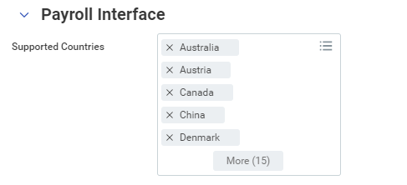
Payroll Interface Countries
Navigate to the task Edit Tenant Setup – HCM and scroll down to the Payroll Interface Section.

Slide 15
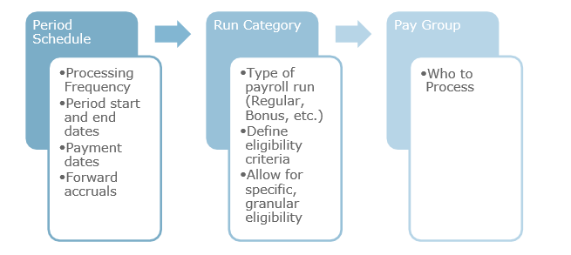
Period Schedules
A Period Schedule shows how periods are defined by specified start and end dates, their frequency, and where the schedule is used in the system.
Notes:
These can be shared by different processes but our focus for this course is how the Payroll process uses the Period Schedule. Define a period schedule and frequency for employee payment, such as weekly, bi-weekly, or monthly. This is how Payroll Interface calculates and distributes payment. Pay periods are derived from the Period Schedule.

Slide 16
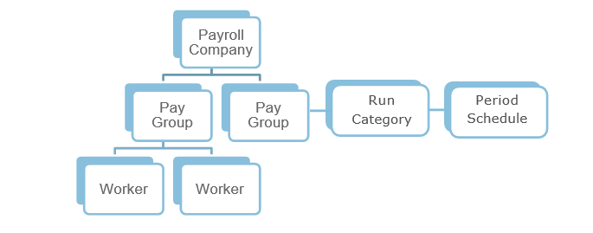
Pay Group / Pay Group Hierarchy
Pay Groups identify who to pay, the pay frequency, and which payments to process by tying together the Pay Period and Run Category previously defined.
A Pay Group is a group of workers in Workday who are paid in the same way, including:
Same frequency
Same period begin and end dates
Same pay dates
Same pay check dates
Notes:
RUN CATEGORY
Each Pay Group is assigned a Run Category. Pay Groups used for Payroll Interface may only have a single Run Category. A Run Category may only have one Period Schedule. The Period Schedule defines the start and end dates of the pay periods. In the setup, indicate that the Run Category is used in Payroll Interface.

Slide 17
Payroll Company
PAYROLL COMPANY
All of the individual Pay Groups you create roll up into a Payroll Company. Usually this represents the payroll vendor you are using (for example, ADP Payroll). Sometimes companies have a more complex way of grouping and paying employees. For instance, if the organization has one payroll vendor used for the UK and another for the U.S., each of these processes would be represented by a unique Payroll Company. Within these Payroll Companies, we can define different Groups who share common ways of being paid and/or periods of payment.

Slide 18
External Earnings and Deductions
EXTERNAL PAYROLL EARNINGS
Include direct compensation such as salary, bonuses, and allowances, as well as indirect compensation (taxable benefits) such as health care costs paid by the employer that are categorized as taxable
Use: Maintain External Payroll Earnings task
EXTERNAL PAYROLL DEDUCTIONS
Include employee contributions to health care or life insurance plans
Use: Maintain External Payroll Deductions task

Slide 19
Integration System Planning
What/how many integration systems need to be created? Outbound? Inbound? How many Pay Companies?
For each integration system, how many clones are needed for testing (typically one for testing and manual runs and one for scheduled runs)?
Which data and events should be included in the output?
Who are the Pay Groups, what is the Pay Schedule, and how should runs be scheduled to ensure proper change detection for requirements?
How should Workday field values map to the third-party payroll system?
How should Workday fields map to third-party payroll system? Is a Document Transform or Studio required?
In what format should the output file be sent? Is a Document Transform or Studio required?
How is the output file to be delivered to the payroll system?

Slide 20
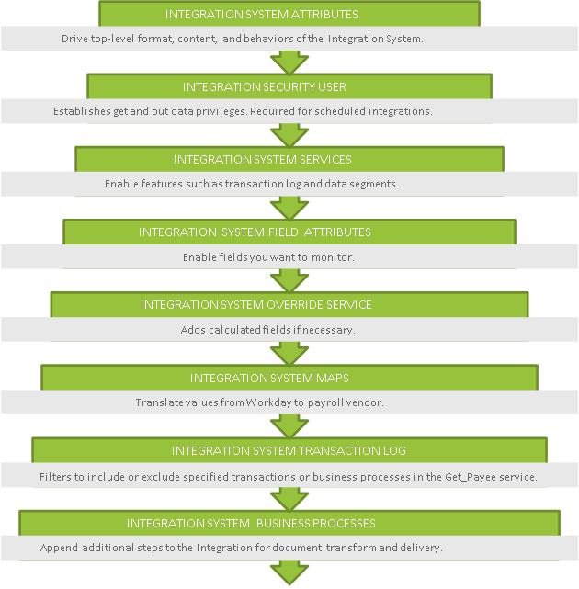
Notes:
An Integration System is an object in Workday that stores the configuration of the integration. The diagram shows the flow of configurable features and services used to set up and manage the system.

Slide 21
Payroll Interface Example

Slide 22
Payroll Interface Attribute Configuration
Provides configuration to control:
Desired output format
Desired change detection strategies for data sections
Additional data selection parameters
Formatting options

Slide 23
Payroll Interface Mapping Configuration
Provides configuration for:
Mapping Workday codes to vendor-specific values

Slide 24
Extending Payroll Interface
Custom Fields available for extending data
Custom Field Names are user-defined
Insert unlimited number of custom fields

Slide 25
Payroll Interface Launch Options
Pay Group
Pay Period Selection Option
Pay Group Members
Exclude Members/Only Include Members
Last Successful Run
Basic Staffing Transaction Log Types
Change Detection
Full Extract With No Diff

Slide 26
Payroll Event Information
Integration Event Details:
Output Files tab that contains source file, data audit and diagnostic tools
Launch parameters
Messages – informational and warning/errors

Slide 27
Payroll Interface Audit Files
Recap of integration data
Includes employees with changes
Changed employee data is highlighted
Includes only data configured to be included in integration file
Designed to be a reconciliation tool
Places auditing into the hands of the functional user

Slide 28
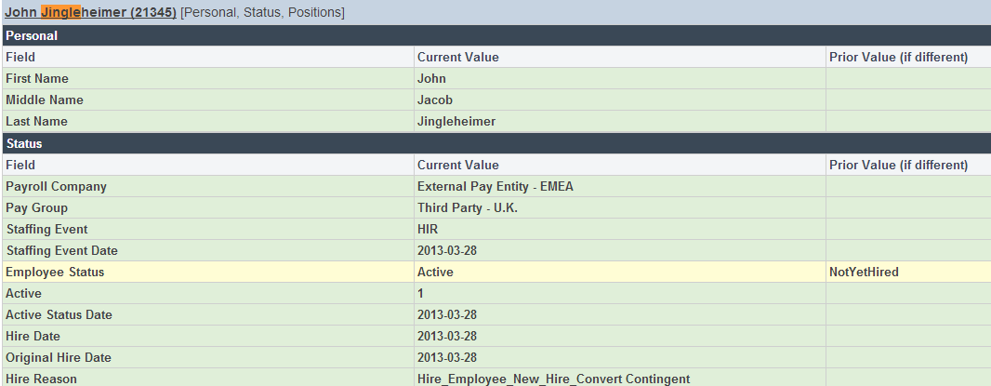
Data Change Audit Sample

Slide 29
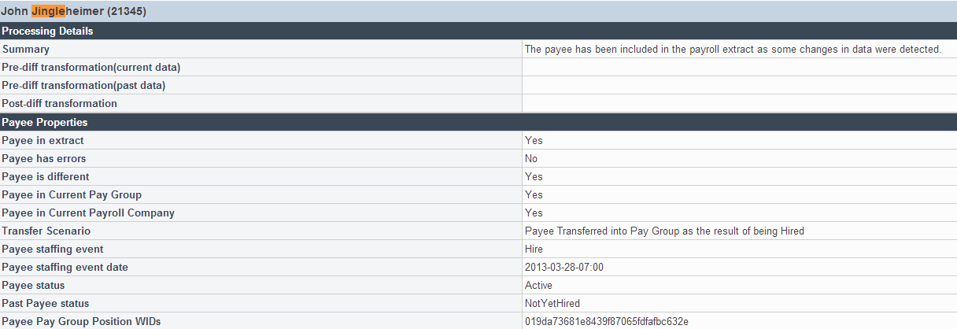
Diagnostic Audit Sample

Slide 30
Day 1 Activities & Questions

Slide 31

About Deloitte Deloitte refers to one or more of Deloitte Touche Tohmatsu Limited, a UK private company limited by guarantee (“DTTL”), its network of member firms, and their related entities. DTTL and each of its member firms are legally separate and independent entities. DTTL (also referred to as “Deloitte Global”) does not provide services to clients. Please see www.deloitte.com/about for a detailed description of DTTL and its member firms. Please see www.deloitte.com/us/about for a detailed description of the legal structure of Deloitte LLP and its subsidiaries. Certain services may not be available to attest clients under the rules and regulations of public accounting. Copyright © 2016 Deloitte Development LLC. All rights reserved. 36 USC 220506 Member of Deloitte Touche Tohmatsu Limited

